Slide 1
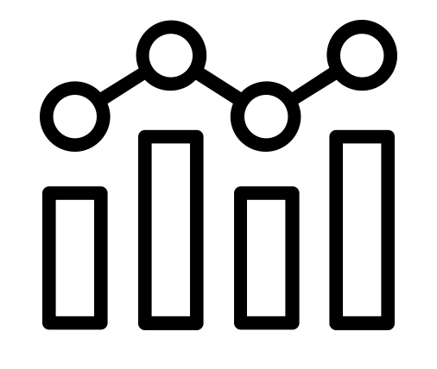
The Future of Taxi Operations
SchwarzShuttle:
GCP Architecture for Real-Time Intelligence at Global Scale
Presented By: Thibault G

Slide 2
Business Context & Challenges
Our global taxi business operates at a massive scale, ensuring seamless transportation services worldwide.
Operational Scale:
Fleet of 11,000+ taxis operating 24/7
Serving millions of passengers across multiple cities
Integrating technology for real-time booking and tracking
Key Challenges:
Data Management: Handling vast amounts of trip, customer, and payment data efficiently
Security: Ensuring the protection of sensitive user and financial data
Fraud Prevention: Detecting and mitigating fraudulent transactions and unauthorised access
Optimisation: Enhancing route planning, driver allocation, and fuel efficiency with AI-driven solutions

Slide 3
Solution Requirements
Functional Requirements:
Trip data collection and processing
Real-time fleet monitoring and dispatch
Revenue analysis and receipt generation
Secure payment processing
Customer communications management
Non-Functional Requirements:
Performance: Low latency for real-time operations
Scalability: Support for global operations across time zones
Security: Protection of sensitive customer and payment data
Reliability: 24/7 availability with fault tolerance
Maintainability: Component-level updates without service disruption

Slide 4
Data Ingestion & Processing Patterns
Payment Info
Driver Ratings & Feedback
Fares, transaction logs, payment methods.
Processed with CMEK encryption for PCI-DSS compliance
Secured via service-specific IAM roles and data governance
Service quality assessment.
Inputs to ML models for performance optimisation
Triggers operational alerts via Cloud Functions
Trip Data
GPS Data
Start/end locations, distance, duration.
Processed via Pub/Sub → Cloud Functions → BigQuery
~500MB daily data volume across fleet
Real-time vehicle tracking, traffic conditions.
Streamed via Cloud IoT Core → Pub/Sub → Real-time analytics
High-frequency data (5-10 sec intervals) requiring scalable ingestion

Slide 5
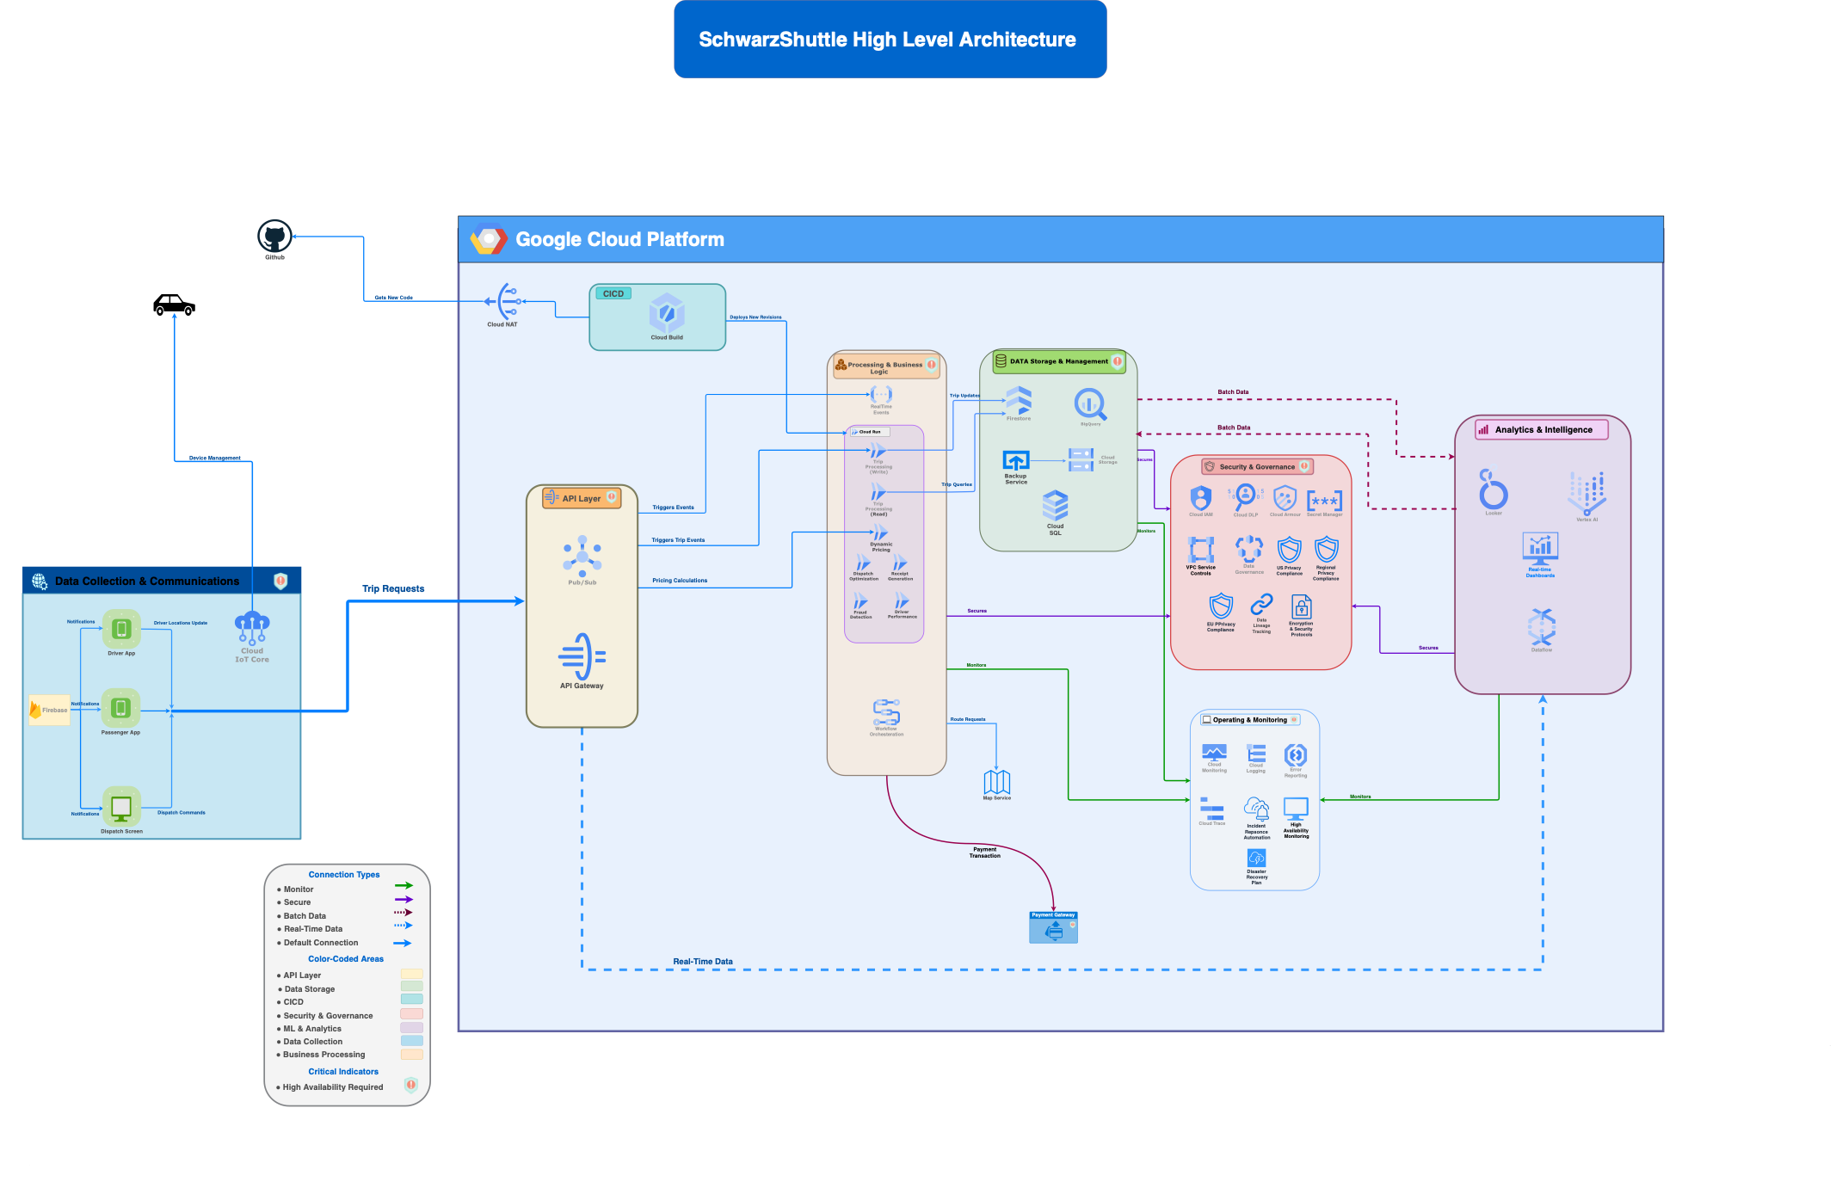
High-Level Architecture
Key Points:
Complete Data Lifecycle: From taxi collection to analytics insights
Event-Driven Design: Real-time processing via Pub/Sub messaging
Layered Security: Defense-in-depth across all components
API-First Approach: Flexible integration for mobile and IoT devices
Intelligence Layer: ML-powered optimization and business insights
View high-resolution diagram here, and download drawio source file here

Slide 6
Detailed System Architecture
Key Points:
Event-Driven Core: Pub/Sub messaging enables real-time processing across all services
Service Specialization: Dedicated microservices for trip, payment, and telemetry workflows
Data Pipeline Integration: Seamless flow from operational systems to analytics
ML Feedback Loop: Continuous intelligence from data collection to prediction deployment
Defense-in-Depth: Security controls implemented at each architectural layer
View high-resolution diagram here, and download drawio source file here

Slide 7
GCP Implementation
Pub/Sub
(Real-Time Messaging
& Event Streaming)
BigQuery
(Scalable Data Warehouse)
Cloud Functions (Serverless Compute for Automation)
Vertex AI
(Machine Learning & Optimization)
IAM & Security Tools (Access Control & Threat Detection)
Enables real-time ingestion of IoT device data for fleet operations.
Supports event-driven processing, triggering Cloud Functions for automation.
Stores and analyzes trip revenue, fleet performance, and fraud detection data.
Uses CMEK encryption for secure data protection.
Supports executive dashboards and analytics for decision-making.
Automates data processing, security monitoring, and fraud detection.
Orchestrates workflows triggered by Pub/Sub events.
Powers fleet optimization and fraud prevention models.
Enables predictive maintenance for vehicles.
IAM enforces least privilege access to services.
Log Sinks track security incidents in BigQuery.
SonarQube, Trivy, OWASP ZAP integrate into CI/CD for security scans.

Slide 8




Deployment Objectives
Security
Scalability
Optimization
Protects sensitive trip and revenue data from cyber threats.
Implements Customer-Managed Encryption Keys (CMEK) for secure storage.
Enforces IAM with least privilege access to prevent unauthorised access.
Integrates log monitoring and security scans (SonarQube, Trivy, OWASP ZAP) in CI/CD.
Supports auto-scaling to handle growing data from IoT devices.
Ensures low-latency processing during peak fleet operations.
Adapts to multi-region deployments for global expansion.
Enhances real-time fleet management using ML-powered insights.
Reduces operational costs through intelligent resource allocation.
Improves user experience with efficient and seamless data processing.

Slide 9
Automation Strategy
1
Dual Approach: Terraform (Primary) + Python (alternative)
Rationale: • Terraform for declarative infrastructure
• Python for dynamic resource provisioning, complex logic
2
3
Key Capabilities: • Component-level deployment
• Security configuration
Benefit: Hours → Minutes deployment time
4

Slide 10
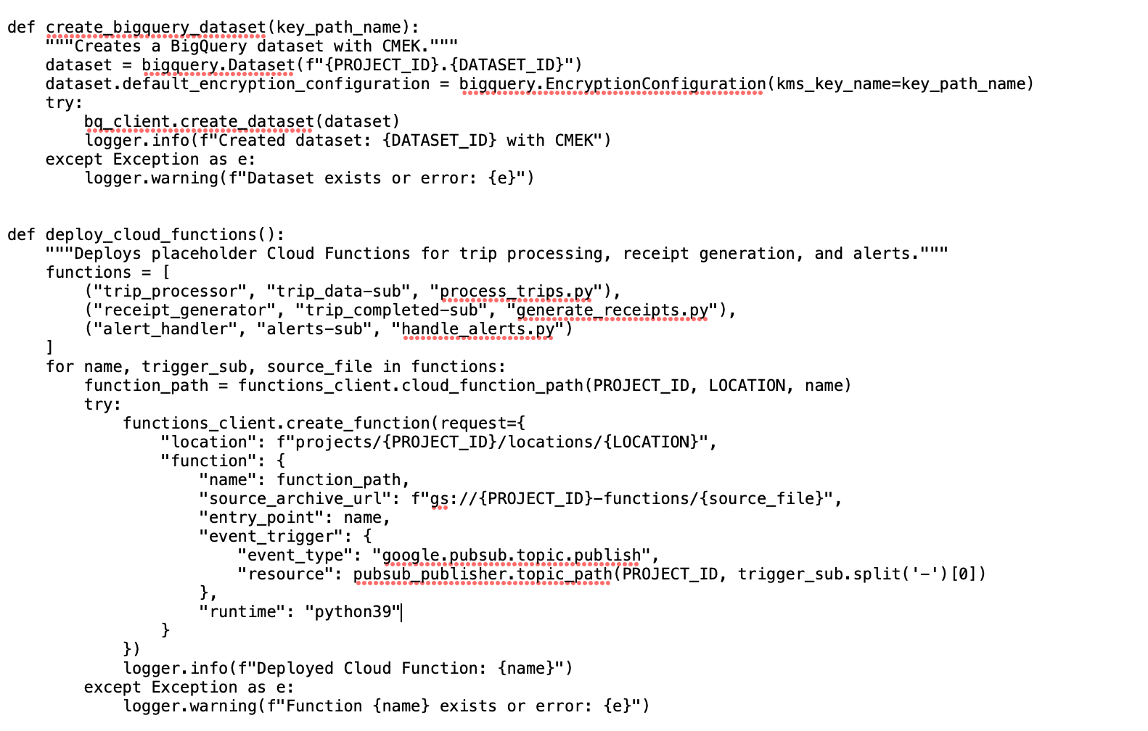
Python Deployment Script
Key Points:
Component-Level Deployment: Each service deployed independently
Event-Driven Architecture: Functions triggered by Pub/Sub events
Idempotent Operations:Includes error handling for resilience
Configuration Flexibility: Customisable runtime and locations
Audit Logging: Deployment actions tracked for accountability
Browse complete repository here

Slide 11
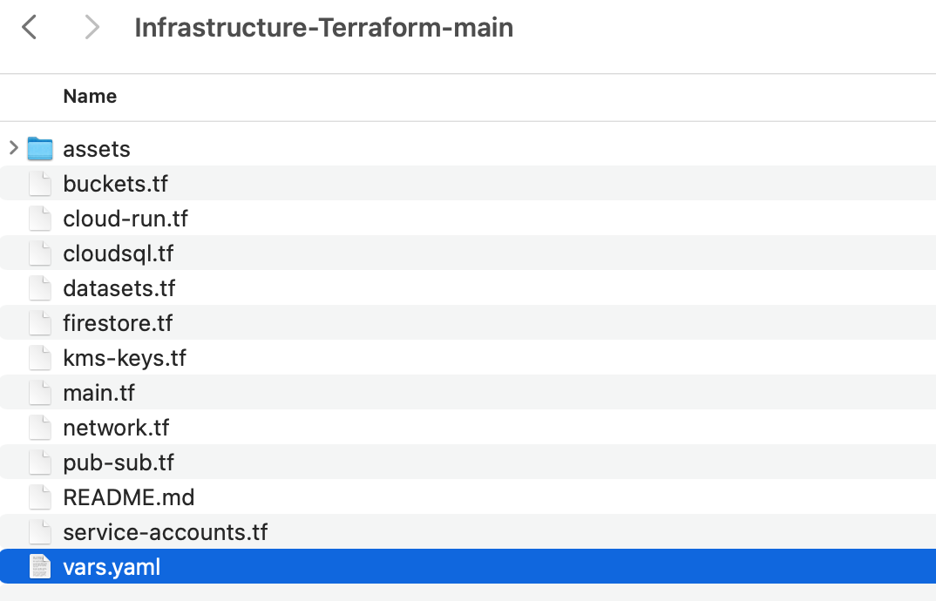
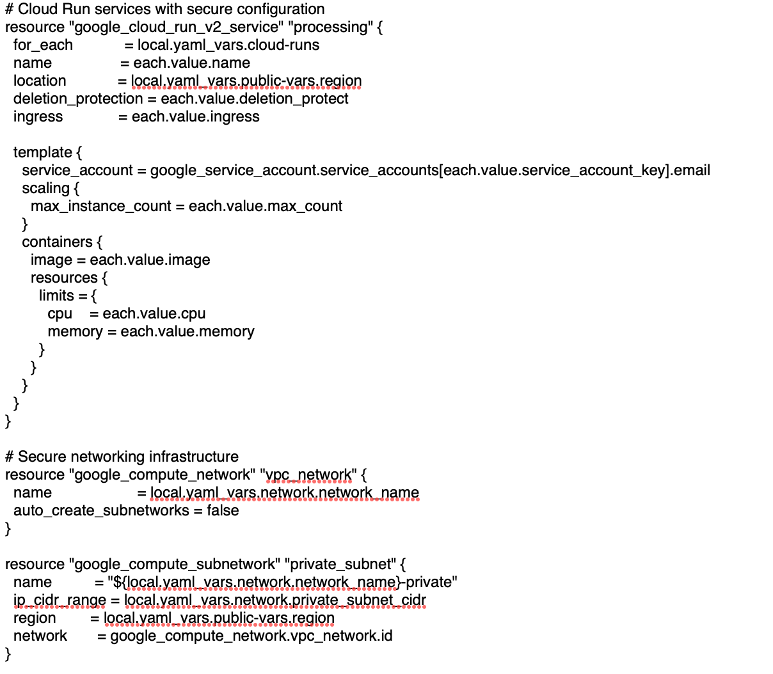
Terraform Infrastructure
Key Points:
Configuration as Code: Complete infrastructure defined in version control
Modular Architecture: Separated services with dedicated resources
Security-First Design: Private networking and service-specific accounts
Dynamic Scaling: Automatic resource adjustment based on demand
External Configuration: YAML-driven deployment for environment flexibility
Browse complete repository here

Slide 12
Multi-Layered Security & Data Protection Strategy
Key Points:
Data Infiltration Prevention:
API Gateway Validation
Application-Level Security
Authentication Services
Secure Request Handling
Data Exfiltration Prevention:
Network Perimeter Controls
Restricted Data Movement
Authorized Access Only
Comprehensive Logging & SIEM Monitoring
Key Security Layers:
Perimeter Security: VPC, Firewalls
Identity & Access: IAM with Least Privilege
Data Protection: CMEK Encryption
Application Security: Input Validation, Secure APIs
Comprehensive Protection:
Mitigating External Threats
Managing Insider Risks
End-to-End Security Approach
View high-resolution diagram here, and download drawio source file here

Slide 13
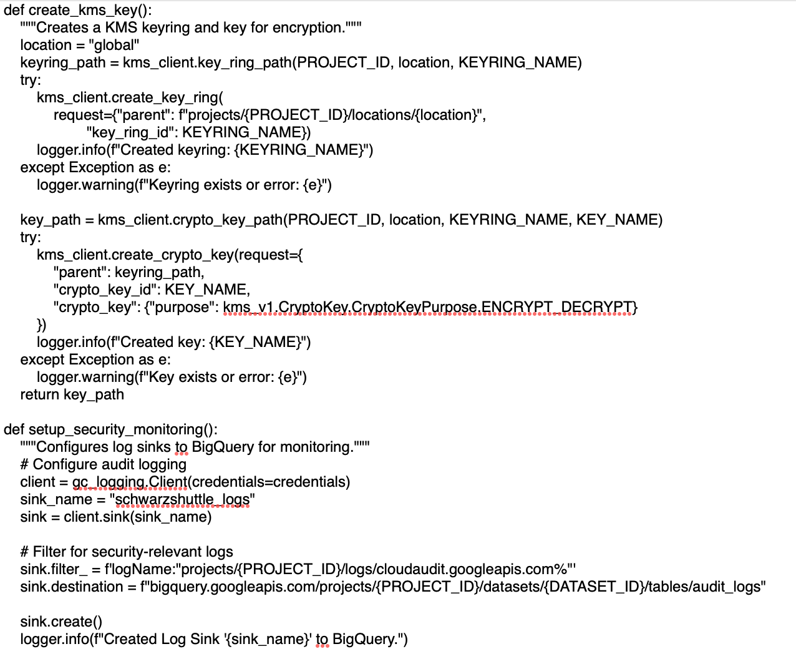
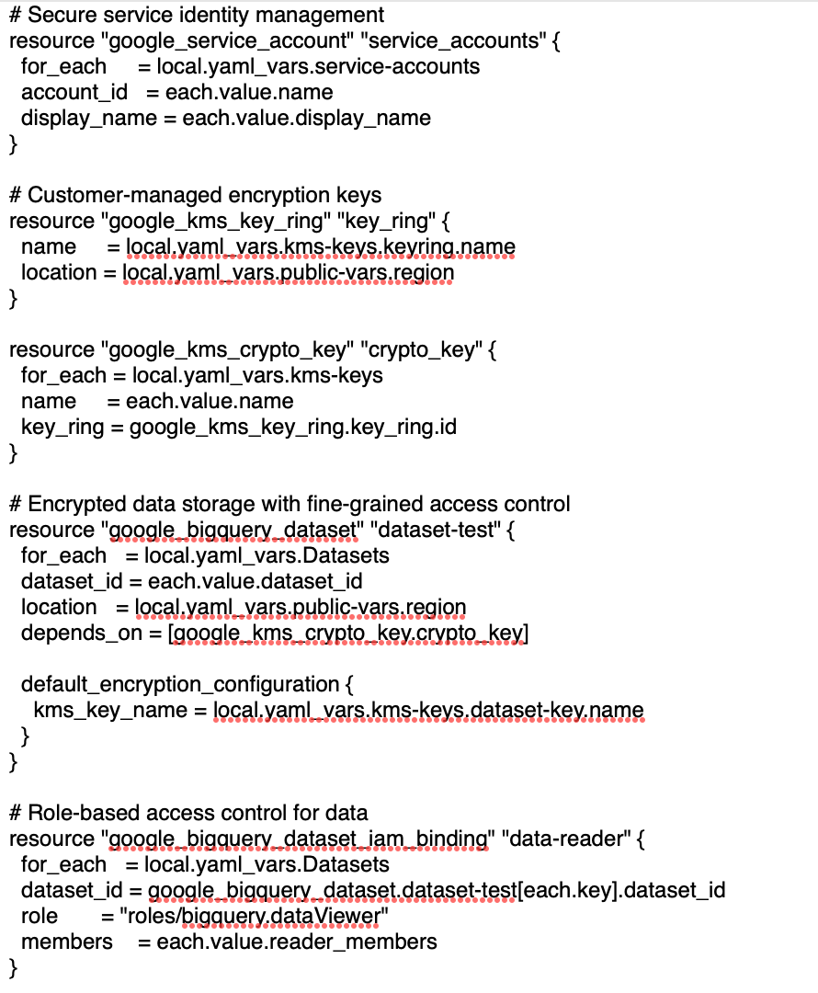
Security Implementation Controls
Python: Data Encryption & Access Control:
Terraform: Network & Security Configuration
Key Security mechanisms demonstrated:
Customer-Managed Encryption Keys
Least Privilege Access Control
Fine-Grained IAM Bindings
Security Monitoring
Resource Isolation

Slide 14
Security Enhancement
Threat Model for Taxi Operations
Regulatory Compliance
GCP Security Implementation
Identity: Cloud Identity MFA for all access
Encryption: CMEK for data-at-rest & in-transit
Access Control: API Gateway with Cloud Armor
Network Isolation: VPC Service Controls
Passenger Data: Personal information, trip history
Payment Security: Transaction processing, fraud prevention
Location Privacy: Trip tracking, route protection
PCI-DSS: Payment card protection
GDPR/CCPA: Privacy controls
Industry: Required ride record retention

Slide 15
GCP Defense-in-Depth for Taxi Operation
Security Command Center
Cloud Logging
Event Threat Detection
Monitoring & Incident Response
Cloud Identity
IAM service accounts
Conditional access
Endpoint & Identity Security
CMEK encryption
Cloud KMS
Cloud DLP
Data Security
Cloud Armor
API Gateway
Container security
Application Security
Perimeter Security
(Network Level)
VPC Service Controls
Cloud NAT
Secure IoT connectivity

Slide 16
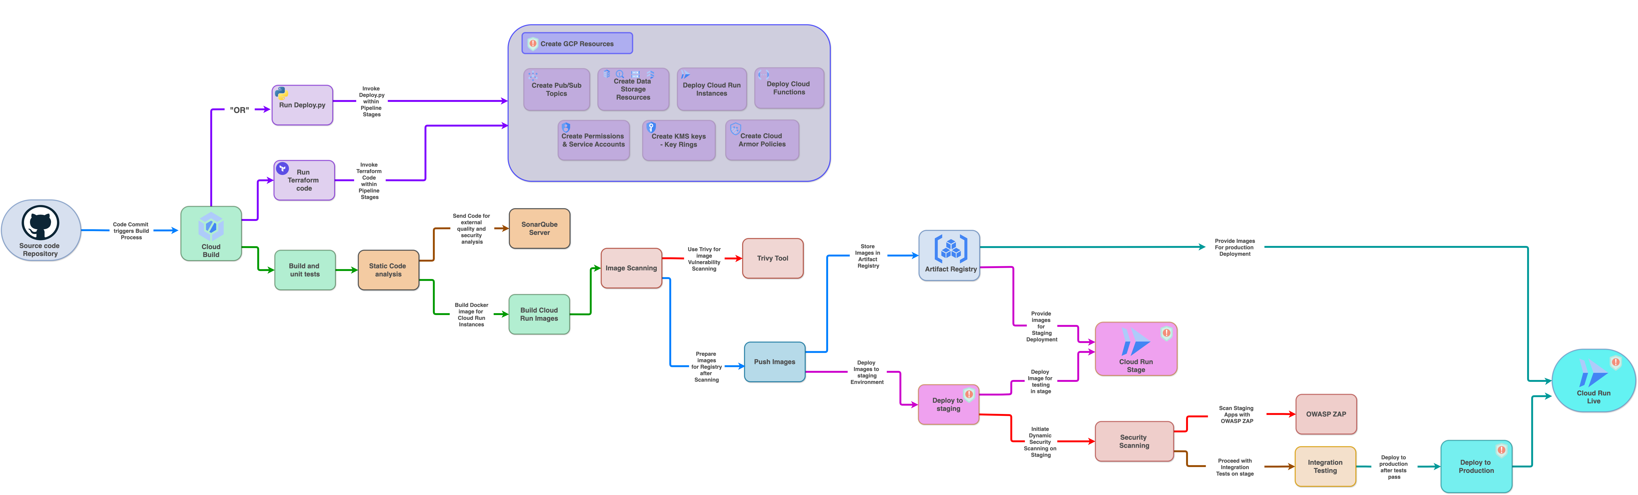
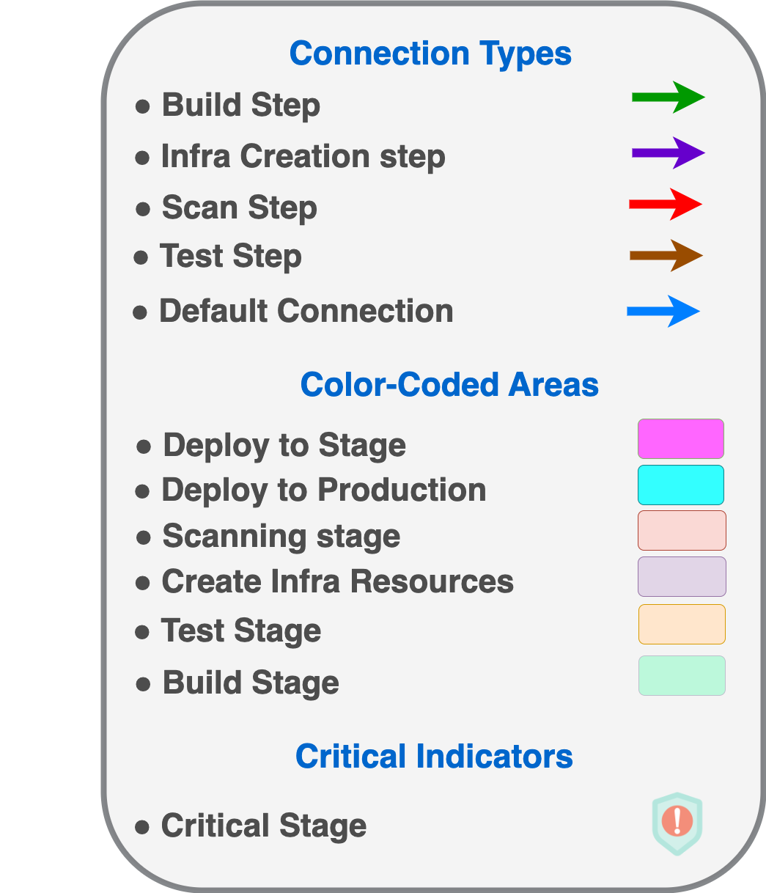
DevSecOps Pipeline
Key Points:
Automated Workflow:
Source Code to Cloud Deployment
Continuous Integration & Delivery
Security Integration:
Image Scanning
OWASP ZAP Security Checks
Vulnerability Assessment
Key Stages:
Build & Test
Security Scanning
Cloud Deployment
Artifact Management
Advanced Features:
Cloud Resource Provisioning
Automated Security Policies
Multi-Environment Support
View high-resolution diagram here, and download drawio source file here

Slide 17
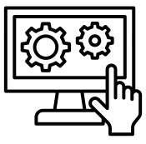
Measurable Improvements
Operational Metrics:
Technical Metrics:
30% reduction in passenger wait times
15% decrease in vehicle idle time
8% increase in revenue per mile
50% faster deployment time
60% reduction in configuration errors
25% reduction in security incidents
30% less service disruption during updates

Slide 18
Our Journey: From Launch to Leadership (2025-2027)
Year 1
Year 2
Year 3
• Enhanced Analytics
• Infrastructure Improvements
• Security Advancements
• Predictive Intelligence
• Customer Experience
• Operational Efficiency
• Autonomous Capabilities
• Sustainability Focus
• Advanced Analytics
Expected Business Outcomes:
Higher utilization rates (less idle time).
Better customer retention (faster rides, optimized pricing).
Cost reduction (fuel savings, route efficiency).

Slide 19
Requirements Fulfilled
Requirement | Implementation | Benefits
Architecture | Complete GCP solution with real-time processing and bidirectional communication | Comprehensive data management, operational control, actionable insights
Automation | Terraform (primary) + Python script (alternative) with component-level updates | Consistent deployments, operational flexibility, faster updates
Security | Defense-in-depth with CMEK, IAM, monitoring | Protected customer data, regulatory compliance, threat prevention
Vision | Strategic 3-year roadmap (2025-2027) | Clear evolution path aligned with business growth

Slide 20
Key Takeaways
Comprehensive Architecture – End-to-end solution for global taxi operations.
Flexible Automation – Terraform + Python options for deployment preferences.
Security By Design – Multi-layered protection for sensitive data.
Measurable Impact – Clear improvements in key business metrics.
Strategic Vision – Forward-looking roadmap for continued innovation.

Slide 21
Driving the Future of Intelligent Mobility
From Data to Movement, From Insights to Action

